Slide 1
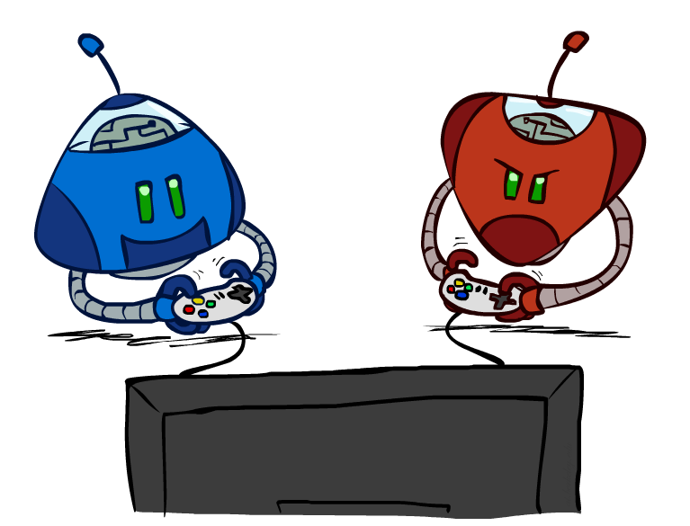
CS 362: Artificial Intelligence
Ch5 : Adversarial Search
Instructor: Malak Abdullah
Jordan University of Science and Technology
[slides adapted from University of California, Berkeley]
Notes:
Please retain proper attribution and the reference to ai.berkeley.edu. Thanks!

Slide 2
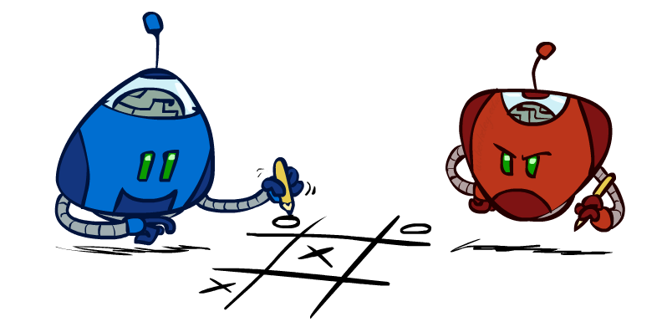
Outline
History / Overview
Minimax for Zero-Sum Games
α-β Pruning
Finite lookahead and evaluation

Slide 3
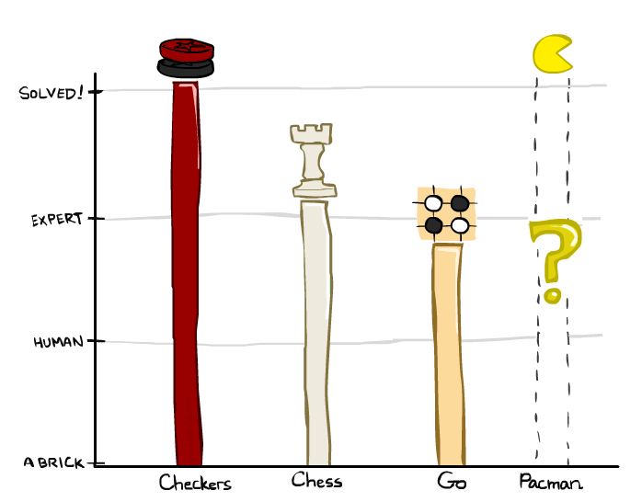
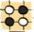
A brief history
Checkers: https://youtu.be/ScKIdStgAfU?t=24
1950: First computer player.
1959: Samuel’s self-taught program.
1994: First computer world champion: Chinook defeats Tinsley
2007: Checkers solved! Endgame database of 39 trillion states
Chess:
1945-1960: Zuse, Wiener, Shannon, Turing, Newell & Simon, McCarthy.
1960s onward: gradual improvement under “standard model”
1997: Deep Blue defeats human champion Gary Kasparov
2021: Stockfish rating 3551 (vs 2870 for Magnus Carlsen).
Go:
1968: Zobrist’s program plays legal Go, barely (b>300!)
1968-2005: various ad hoc approaches tried, novice level
2005-2014: Monte Carlo tree search -> strong amateur
2016-2017: AlphaGo defeats human world champions
Pacman
Notes:
Tinsley lost only 5 games to humans in 42 years; has been known to solve 60-ply problems

Slide 4
Games
multiagent environments
In this chapter we cover competitive environments
The agents’ goals are in conflict
adversarial search problems—often known as games

Slide 5
Most common games
Deterministic, fully observable environments in which two agents act alternately and in which the utility values at the end of the game are always equal and opposite.
For example, if one player wins a game of chess, the other player necessarily loses.
It is this opposition between the agents’ utility functions that makes the situation adversarial.

Slide 6
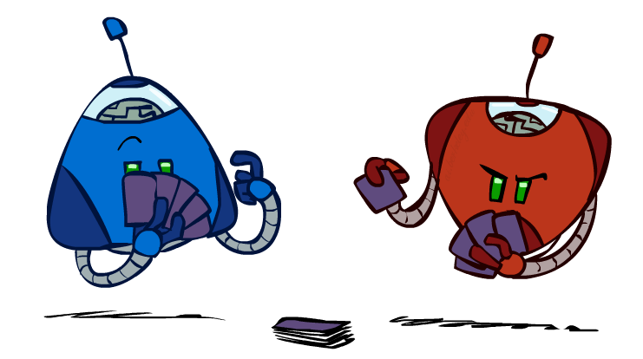
Types of Games
Game = task environment with > 1 agent
Axes:
Deterministic or stochastic?
Perfect information (fully observable)?
One, two, or more players?
Turn-taking or simultaneous?
Zero sum?
Want algorithms for calculating a contingent plan (a.k.a. strategy or policy) which recommends a move for every possible eventuality

Slide 7
Min-Max Games
We first consider games with two players, whom we call MAX and MIN
MAX moves first, and then they take turns moving until the game is over.
At the end of the game, points are awarded to the winning player and penalties are given to the loser.

Slide 8
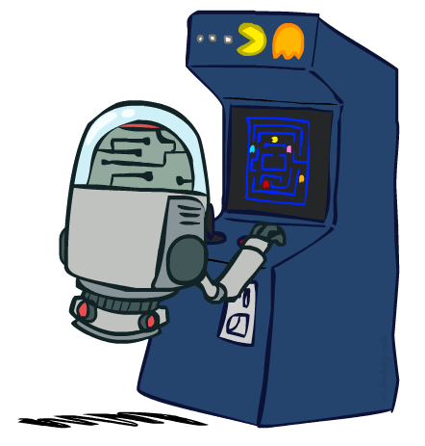
“Standard” Games
Standard games are deterministic, observable, two-player, turn-taking, zero-sum
Game formulation:
Initial state: s₀
Players: Player(s) indicates whose move it is
Actions: Actions(s) for player on move
Transition model: Result(s,a)
Terminal test: Terminal-Test(s)
Terminal values: Utility(s,p) the final numeric value for a game that ends in terminal state s for a player p.
Or just Utility(s) for player making the decision at root
In chess, the outcome is a win, loss, or draw, with values +1, 0, or 1/2 .

Slide 9
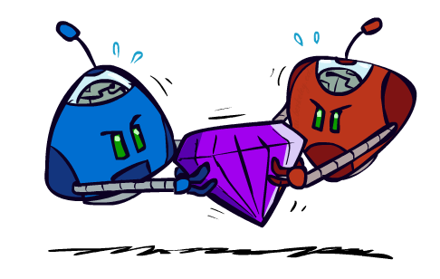
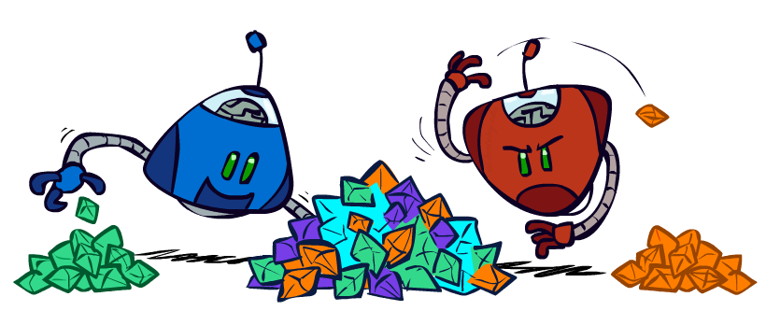
Zero-Sum Games
Zero-Sum Games
Agents have opposite utilities
Pure competition:
One maximizes, the other minimizes
General Games
Agents have independent utilities
Cooperation, indifference, competition, shifting alliances, and more are all possible
A zero-sum game is (confusingly) defined as one where the total payoff to all players is the same for every instance of the game.
Chess is zero-sum because every game has payoff of either 0 + 1, 1 + 0 or ½ + ½

Slide 10

Adversarial Search

Slide 11
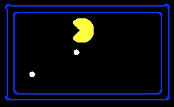
Single-Agent Trees
8
The initial state, ACTIONS function, and RESULT function define the game tree for the Game
a tree where the nodes are game states and the edges are moves.
2
0
…
2
6
…
4
6
Notes:
10 points for eating dot; -1 for each time step

Slide 12
Value of a State
Value of a state: The best achievable outcome (utility) from that state
Non-Terminal States:
V(s) = max V(s’)
s’ ∈ successors(s)
8
2
0
…
2
6
…
4
6
Terminal States:
V(s) = known

Slide 13

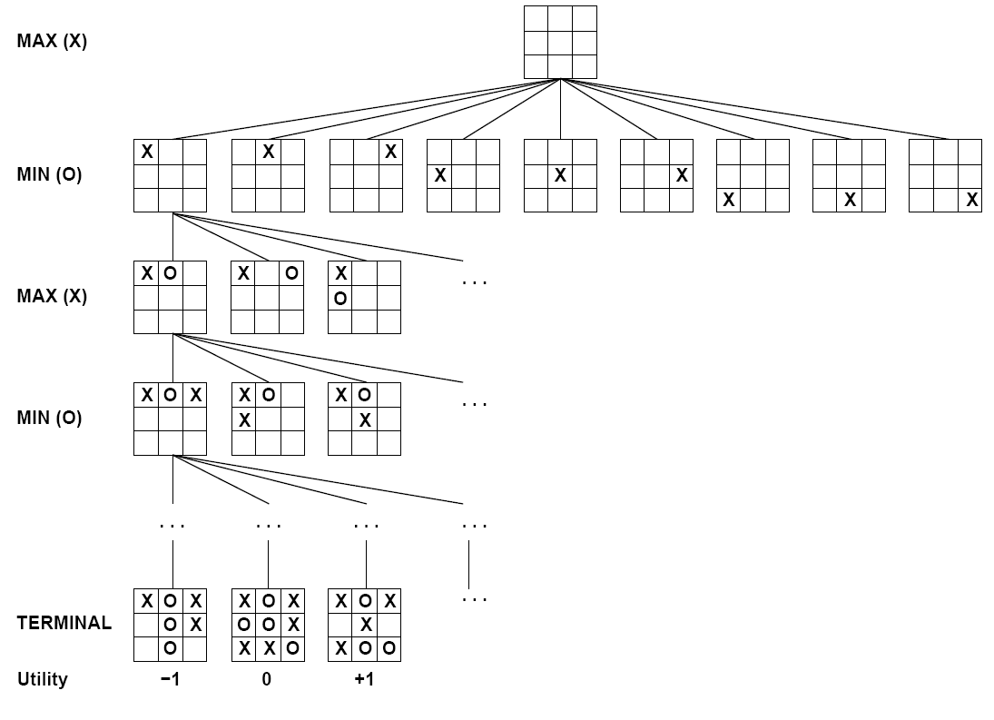

Tic-Tac-Toe Game Tree
For tic-tac-toe the game tree is relatively small—fewer than 9! = 362, 880 terminal
nodes. But for chess there are over 10⁴⁰ nodes.

Slide 14

Minimax Values
MAX nodes: under Agent’s control
V(s) = max V(s’)
MIN nodes: under Opponent’s control
V(s) = min V(s’)
s’ ∈ successors(s)
s’ ∈ successors(s)
-8
-8
-10
-8
-5
-10
+8
Terminal States:
V(s) = known

Slide 15
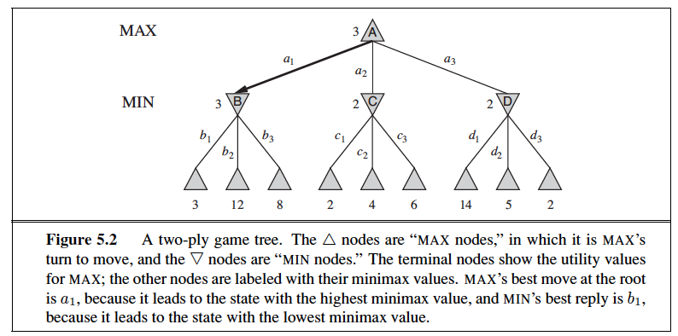
Minimax algorithm
Choose action leading to state with best minimax value
Assumes all future moves will be optimal
=> rational against a rational player

Slide 16
Implementation
function minimax-decision(s) returns an action
return the action a in Actions(s) with the highest minimax_value(Result(s,a))
function minimax_value(s) returns a value
if Terminal-Test(s) then return Utility(s)
if Player(s) = MAX then return max_{a in Actions(s)} minimax_value(Result(s,a))
if Player(s) = MIN then return min_{a in Actions(s)} minimax_value(Result(s,a))

Slide 17
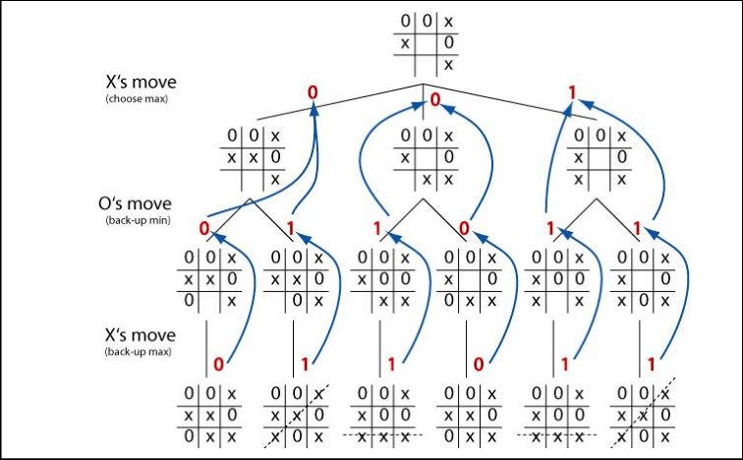
Example

Slide 18
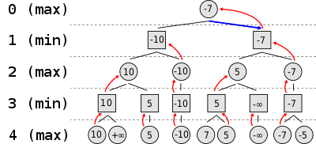

Slide 19
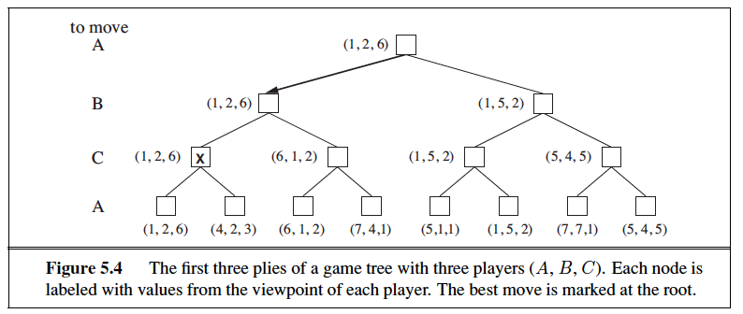
Three-Players
What if the game is not zero-sum, or has multiple players?
First, we need to replace the single value for each node with a vector of values.
In that state, player C chooses what to do. The two choices lead to terminal states with utility vectors (1,2,6) (4, 2, 3).

Slide 20



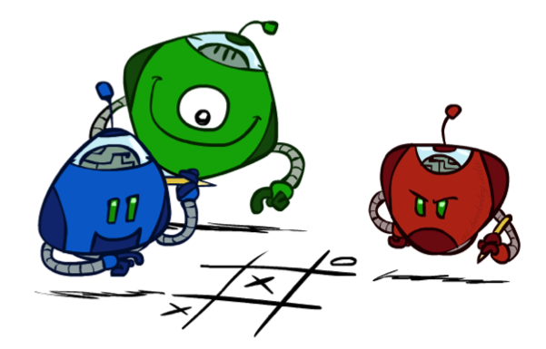
Generalized minimax
Generalization of minimax:
Terminals have utility tuples
Node values are also utility tuples
Each player maximizes its own component
Can give rise to cooperation and
competition dynamically…
8,8,1
8,8,1
7,7,2
0,0,7
8,8,1
7,7,2
0,0,8
1,1,6
0,0,7
9,9,0
8,8,1
9,9,0
7,7,2
0,0,8
0,0,7
Notes:
If both ghosts go the same way, pacman wins; if they go different ways, pacman loses

Slide 21
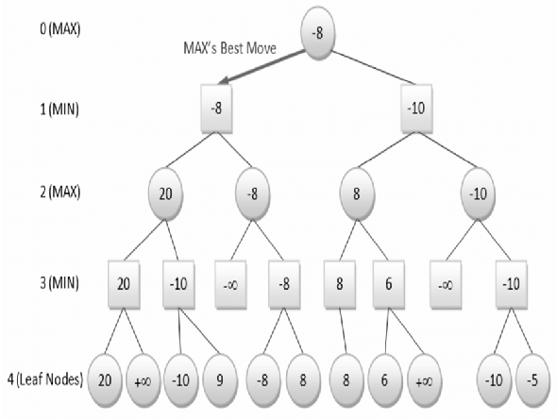
2-players
It uses a simple recursive computation
The minimax algorithm performs a complete depth-first exploration of the game tree.

Slide 22
Minimax Efficiency
How efficient is minimax?
Just like (exhaustive) DFS
Time: O(b^{m})
Space: O(bm)
Example: For chess, b ≈ 35, m ≈ 100
Exact solution is completely infeasible
Humans can’t do this either, so how do we play chess?

Slide 23
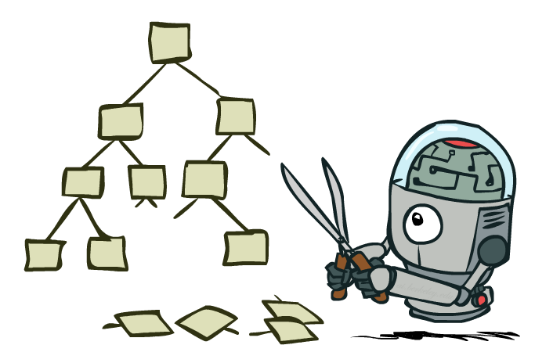
Game Tree Pruning

Slide 24
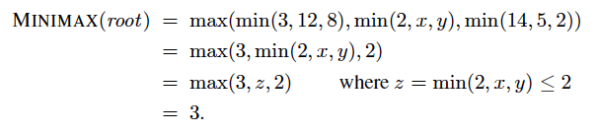
Minimax Example
3
3
2
2
3
12
8
2
4
6
14
5
2
Notes:
Add values by hand if on tablet, or add by animation steps

Slide 25
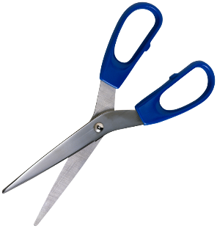
Alpha-Beta Example
α = best option so far from any
MAX node on this path
3
α =3
α =3
3
3
12
8
2
14
5
2
The order of generation matters: more pruning
is possible if good moves come first
Notes:
Add values by hand if on tablet, or add by animation steps

Slide 26
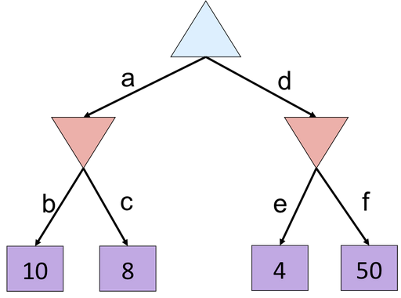
Alpha-Beta Quiz
Notes:
f is not evaluated

Slide 27
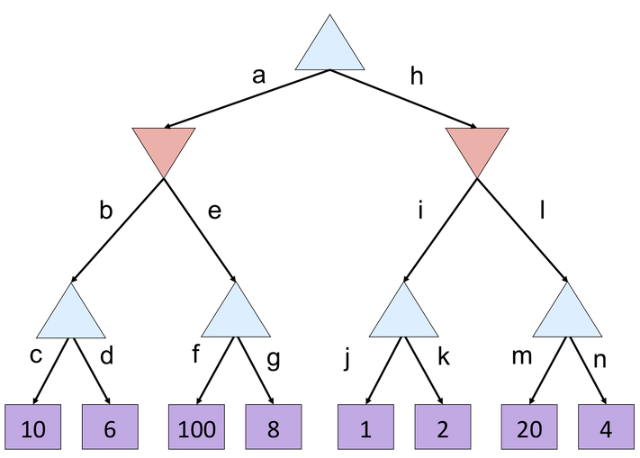
Alpha-Beta Quiz 2

Slide 28
Alpha-Beta Quiz 2
α =
10
?
β =
10
β =
2
?
?
1
2
α=
α=
10
α=
100
?
?
?

Slide 29
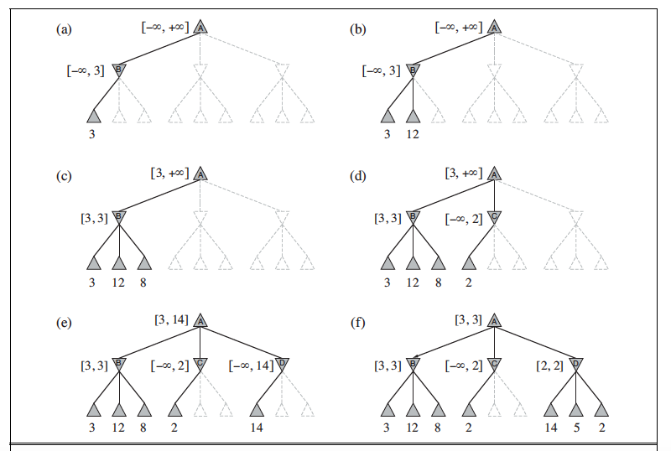

Slide 30
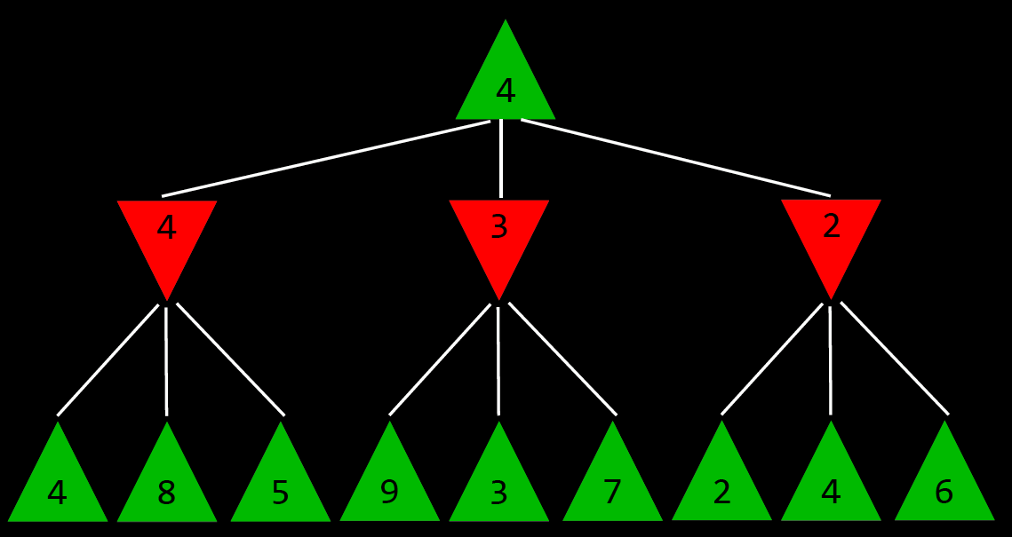

Slide 31
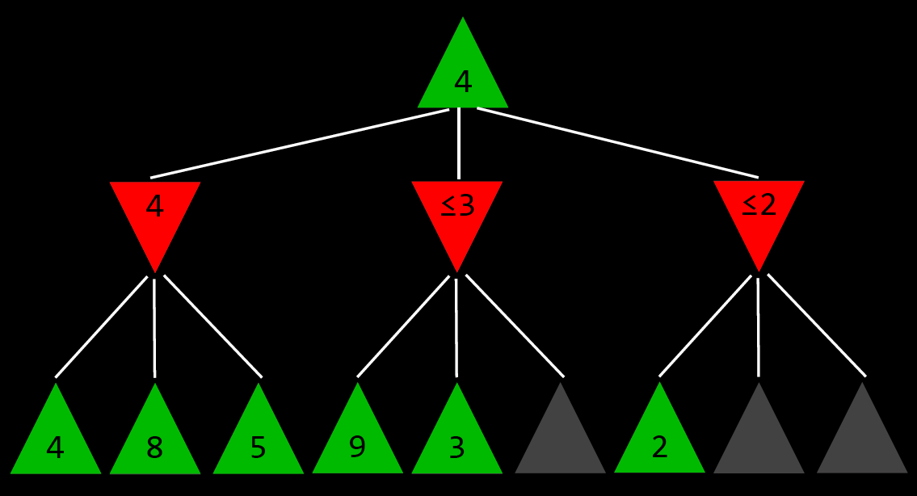

Slide 32
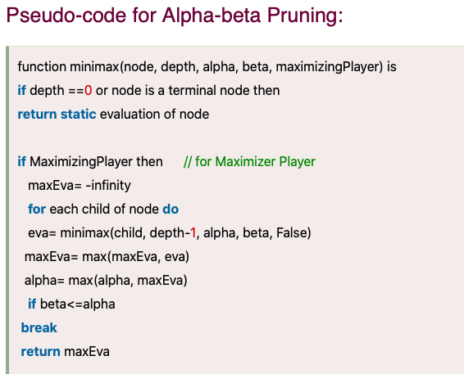
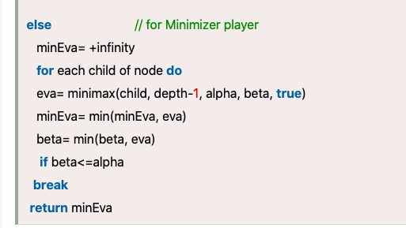

Slide 33
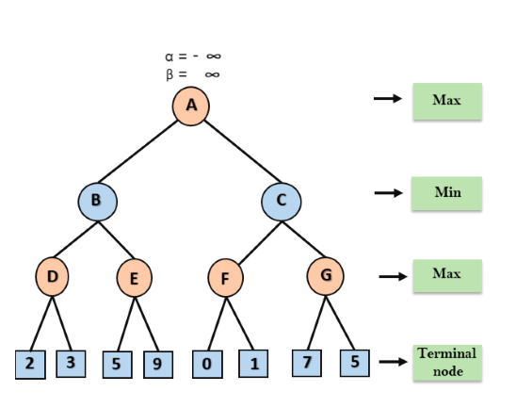
Example
Step 1: At the first step the, Max player will start first move from node A where α= -∞ and β= +∞,
these value of alpha and beta passed down to node B where again α= -∞ and β= +∞,
and Node B passes the same value to its child D.

Slide 34
Continue
Step 2: At Node D, the value of α will be calculated as its turn for Max.
The value of α is compared with firstly 2 and then 3, and the max (2, 3) = 3 will be the value of α at node D
and node value will also 3.

Slide 35
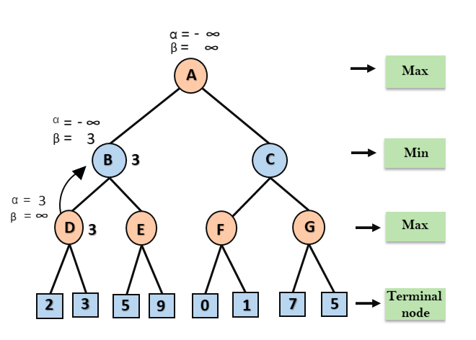
Continue
Step 3: Now algorithm backtrack to node B, where the value of β will change as this is a turn of Min,
Now β= +∞, will compare with the available subsequent nodes value,
i.e. min (∞, 3) = 3, hence at node B now α= -∞, and β= 3.

Slide 36
Continue
In the next step, algorithm traverse the next successor of Node B which is node E, and the values of α= -∞, and β= 3 will also be passed.

Slide 37
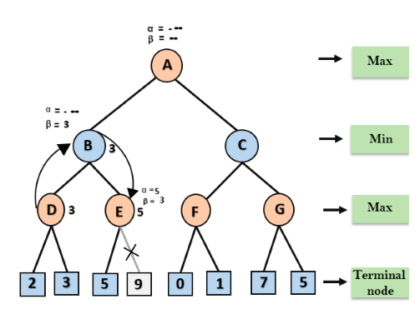
Continue
Step 4: At node E, Max will take its turn, and the value of alpha will change.
The current value of alpha will be compared with 5,
so max (-∞, 5) = 5, hence at node E α= 5 and β= 3, where α>=β, so the right successor of E will be pruned, and algorithm will not traverse it, and the value at node E will be 5.

Slide 38
Continue
Step 5: At next step, algorithm again backtrack the tree, from node B to node A.
At node A, the value of alpha will be changed the maximum available value is 3 as max (-∞, 3)= 3, and β= +∞, these two values now passes to right successor of A which is Node C.
At node C, α=3 and β= +∞, and the same values will be passed on to node F.

Slide 39
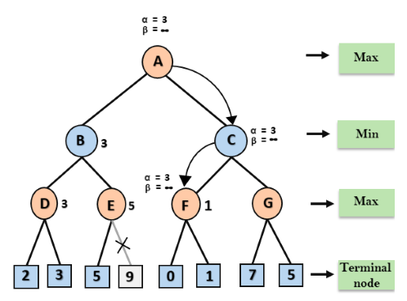
Continue
Step 6: At node F, again the value of α will be compared with left child which is 0, and max(3,0)= 3,
and then compared with right child which is 1, and max(3,1)= 3
still α remains 3,
but the node value of F will become 1.

Slide 40
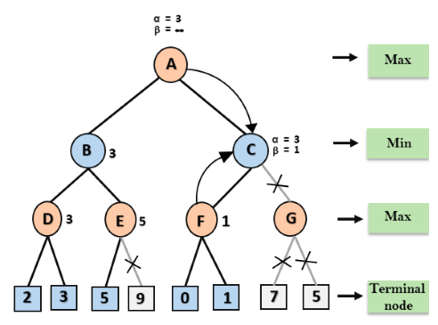
Continue
Step 7: Node F returns the node value 1 to node C, at C α= 3 and β= +∞,
here the value of beta will be changed, it will compare with 1 so min (∞, 1) = 1.
Now at C, α=3 and β= 1, and again it satisfies the condition α>=β,
so the next child of C which is G will be pruned, and the algorithm will not compute the entire sub-tree G.

Slide 41
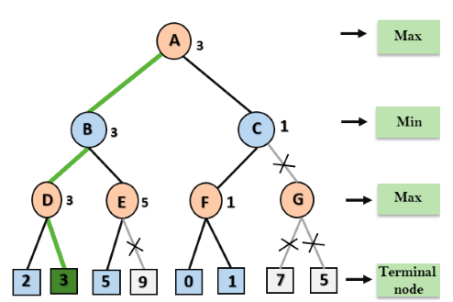
Continue
Step 8: C now returns the value of 1 to A here the best value for A is max (3, 1) = 3.
Following is the final game tree which is the showing the nodes which are computed and nodes which has never computed.
Hence the optimal value for the maximizer is 3 for this example.

Slide 42
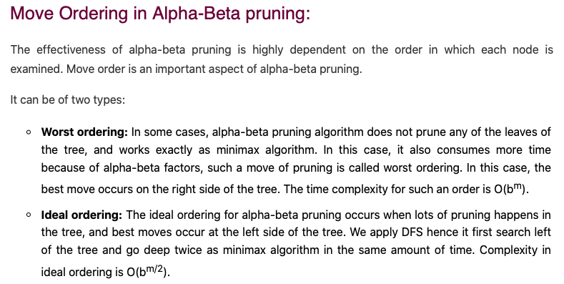

Slide 43
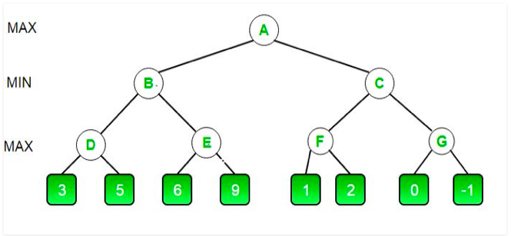
Another Example??
https://www.geeksforgeeks.org/minimax-algorithm-in-game-theory-set-4-alpha-beta-pruning/

Slide 44
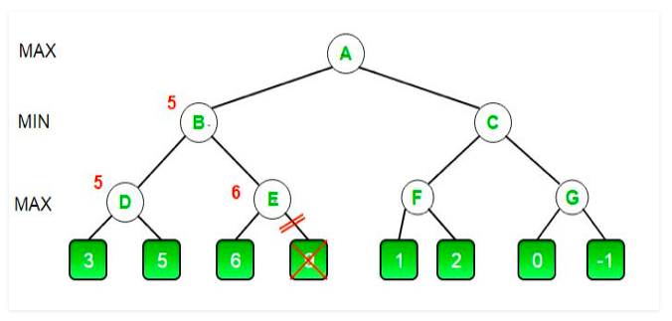

Slide 45
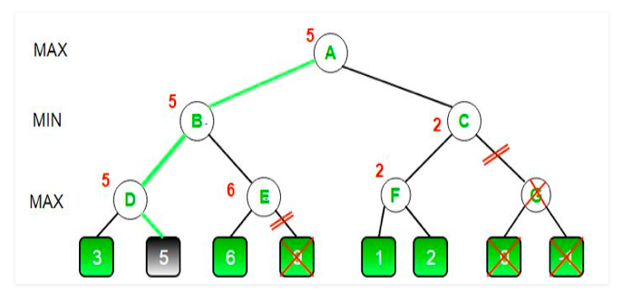

Slide 46
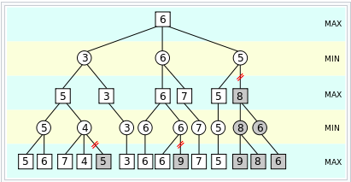
Another example

Slide 47
Alpha-Beta Pruning
General case (pruning children of MIN node)
We’re computing the MIN-VALUE at some node n
We’re looping over n’s children
n’s estimate of the childrens’ min is dropping
Who cares about n’s value? MAX
Let α be the best value that MAX can get so far at any choice point along the current path from the root
If n becomes worse than α, MAX will avoid it, so we can prune n’s other children (it’s already bad enough that it won’t be played)
Pruning children of MAX node is symmetric
Let β be the best value that MIN can get so far at any choice point along the current path from the root
MAX
MIN
a
MAX
MIN
n

Slide 48
Alpha-Beta Implementation
α: MAX’s best option on path to root
β: MIN’s best option on path to root
def max-value(state, α, β):
initialize v = -∞
for each successor of state:
v = max(v, value(successor, α, β))
if v ≥ β
return v
α = max(α, v)
return v
def min-value(state , α, β):
initialize v = +∞
for each successor of state:
v = min(v, value(successor, α, β))
if v ≤ α
return v
β = min(β, v)
return v
Notes:
Pick an order for two reasons: sequential processor and pruning

Slide 49
Alpha-Beta Pruning Properties
Theorem: This pruning has no effect on minimax value computed for the root!
Good child ordering improves effectiveness of pruning
Iterative deepening helps with this
With “perfect ordering”:
Time complexity drops to O(b^{m/2})
Doubles solvable depth!
This is a simple example of metareasoning (reasoning about reasoning)
For chess: only 35⁵⁰ instead of 35¹⁰⁰!! Yaaay!!!!!
max
min
10
10
0

Slide 50

Resource Limits

Slide 51
Resource Limits
Problem: In realistic games, cannot search to leaves!
Solution 1: Bounded lookahead
Search only to a preset depth limit or horizon
Use an evaluation function for non-terminal positions
Guarantee of optimal play is gone
More plies make a BIG difference
Example:
Suppose we have 100 seconds, can explore 10K nodes / sec
So can check 1M nodes per move
Chess with alpha-beta, 35^{(8/2)} =~ 1M; depth 8 is good
max
4
-2
4
min
-1
-2
4
9
?
?
?
?

Slide 52
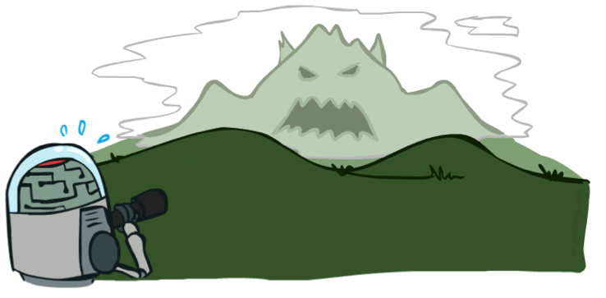
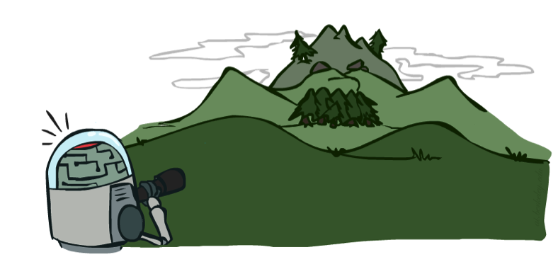
Depth Matters
Evaluation functions are always imperfect
Deeper search => better play (usually)
Or, deeper search gives same quality of play with a less accurate evaluation function
An important example of the tradeoff between complexity of features and complexity of computation
[Demo: depth limited (L6D4, L6D5)]

Slide 53
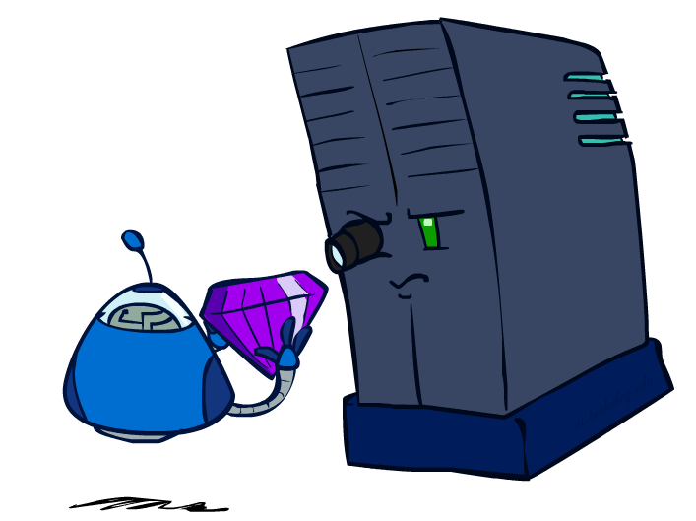
Evaluation Functions

Slide 54
Generalized minimax
What if the game is not zero-sum, or has multiple players?
Generalization of minimax:
Terminals have utility tuples
Node values are also utility tuples
Each player maximizes its own component
Can give rise to cooperation and
competition dynamically…
8,8,1
8,8,1
7,7,2
0,0,7
8,8,1
7,7,2
0,0,8
1,1,6
0,0,7
9,9,0
8,8,1
9,9,0
7,7,2
0,0,8
0,0,7
Notes:
If both ghosts go the same way, pacman wins; if they go different ways, pacman loses

Slide 55
Summary
Games require decisions when optimality is impossible
Bounded-depth search and approximate evaluation functions
Games force efficient use of computation
Alpha-beta pruning
Game playing has produced important research ideas
Reinforcement learning (checkers)
Iterative deepening (chess)
Rational metareasoning (Othello)
Monte Carlo tree search (Go)
Solution methods for partial-information games in economics (poker)
Video games present much greater challenges – lots to do!
b = 10⁵⁰⁰, |S| = 10⁴⁰⁰⁰, m = 10,000

